Slide 1


The Tapscott Learning Trust Teacher Job Profile
Post: Teacher with possible TLR
Scale: MPS including NQTs
This position will either work across the trust or may be permanently based at one of the schools, depending on the needs of the Trust
General Responsibilities
INSPIRE - children daily (or at least as often as possible).
THINK – ‘If you always do what you’ve always done, you’ll always get what you’ve always got,’ Henry Ford.
BE PREPARED - to challenge the status quo. We encourage creative, disruptive thinking; but this must be rooted in research and tracked carefully. ‘We don’t do things to be different; we do things differently when we know they work.’
BE AMBITIOUS – Strive, push, excel, be your best, and give 100% for every child: no excuses, no-one left behind.
ENJOY – If you can’t come to work in a primary school with a smile on your face at least most of the time, you’re probably in the wrong job.
The Tapscott Learning Trust, Atlas Road, London E13 0AG info@ttlt.academy www.ttlt.academy

Slide 2
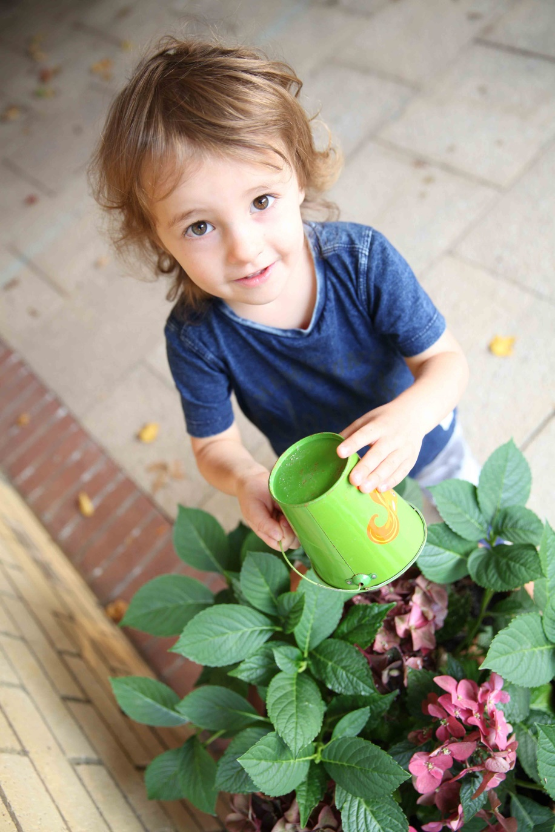

North Beckton Primary School Job Profile
Specific Responsibilities
Teach a class of pupils and ensure that planning, preparation, assessment and reporting meet their varying learning and social needs.
Maintain the positive ethos and core values of the school, both inside and outside the classroom.
Ensure that the current national conditions of employment for school teachers are met.
Implement agreed school policies and guidelines.
Have the highest expectation of every child, believing that every learner has unlimited potential for development.
Set clear targets, based on prior attainment, for pupils learning.
Plan and resource a classroom that will encourage the development of all aspects of children’s learning including their independent use of resources and involvement in their learning.
Set children high standards in the content and presentation of their work by the quality of your displays of that work.
Maintain a positive learning environment, in accordance with the school’s behaviour policy.
Work in partnership with parents and carers in providing a quality education experience for all the children and report to parents on the development, progress and attainment of pupils.
Participate in meetings which relate to the school’s management, curriculum, administration or organisation.
Communicate and co-operate with specialists from outside agencies.
Lead, organise and direct support staff within the classroom.
Participate in the appraisal system.
The Tapscott Learning Trust, Atlas Road, London E13 0AG info@ttlt.academy www.ttlt.academy

Slide 3
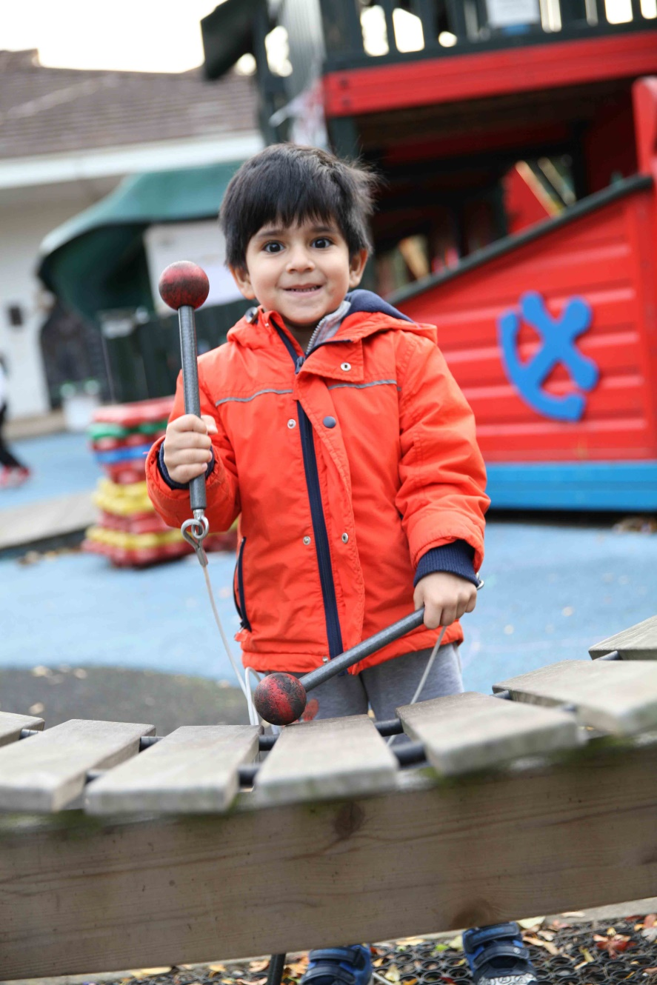
North Beckton Primary School Job Profile
Equality and Diversity
The Tapscott Learning Trust is an Equal Opportunity Employer and recognises that some candidates may have been forced into an untypical or unconventional career path because of unavoidable personal circumstances or the prejudice they have met in life.
Should this apply to you, we hope you will not be deterred from making an application, which will be considered on your overall fulfilment of the requirements of this person’s specification.
As a trust, we are committed to and champion equality and diversity in all aspects of employment with The Tapscott Learning Trust. All employees are expected to understand and promote equality and diversity in the course of their work.
The above are intended to be a guide to the range and level of work expected of any member of staff. It is not an exhaustive list of all the tasks that may be asked of an employee. He/she will be expected to carry out such other reasonable duties, which may be required from time to time across the federation.
We’d love to have a chat about why this could be the next career move for you. Call on 020 3108 0236 and ask to speak to either Danny, Training Hub Director or Paul, CEO. You can talk about the opportunity and get a feel for whether it’s right for you.
To apply, visit www.jobsgopublic.com and search for
‘The Tapscott Learning Trust’.
The Tapscott Learning Trust, Atlas Road, London E13 0AG info@ttlt.academy www.ttlt.academy

