Slide 1


The Tapscott Learning Trust Teacher Person Specification
Post: Teacher with possible TLR
Scale: MPS including NQTs
This position will either work across the trust or may be permanently based at one of the schools, depending on the needs of the Trust
General Responsibilities
INSPIRE - children daily (or at least as often as possible).
THINK – ‘If you always do what you’ve always done, you’ll always get what you’ve always got,’ Henry Ford.
BE PREPARED - to challenge the status quo. We encourage creative, disruptive thinking; but this must be rooted in research and tracked carefully. ‘We don’t do things to be different; we do things differently when we know they work.’
BE AMBITIOUS – Strive, push, excel, be your best, and give 100% for every child: no excuses, no-one left behind.
ENJOY – If you can’t come to work in a primary school with a smile on your face at least most of the time, you’re probably in the wrong job.
The Tapscott Learning Trust, Atlas Road, London E13 0AG info@ttlt.academy www.ttlt.academy

Slide 2
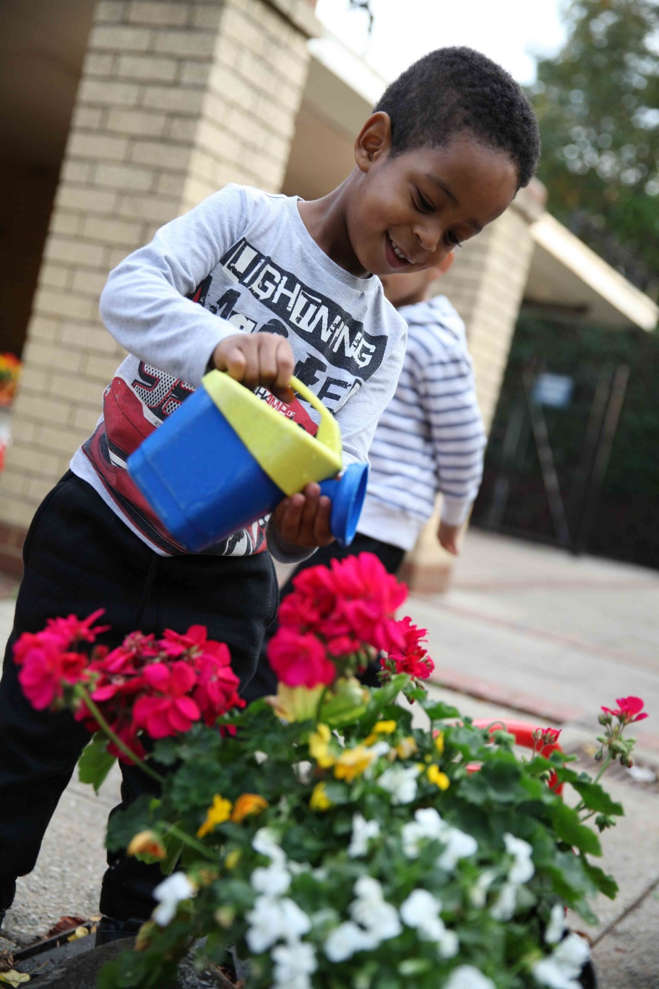
The Tapscott Learning Trust Teacher Person Specification
Characteristics and Competencies
Positive and supportive
Willing to think about what you are doing and why; able to challenge the status quo
A belief that every child can, no matter what their background
Cheerful and resilient enough to maintain that cheerfulness when under pressure
Ambitious for our children and yourself
Organised but still adaptable to change
Committed to equal opportunities and equal value for pupils and colleagues
Committed to keeping children safe and happy
Qualifications and Training
Qualified Teacher status
Evidence of recent professional development
DBS
Experience and Skills
Proven record of raising attainment
High level of expertise in teaching and learning.
An up-to-date knowledge of effective strategies and techniques for raising pupil attainment generally including different groups of pupils such as SEND, EAL.
Good understanding of effective procedures for managing and promoting positive behaviour among pupils.
Experience of a range of summative and formative assessment procedures.
The Tapscott Learning Trust, Atlas Road, London E13 0AG info@ttlt.academy www.ttlt.academy

Slide 3
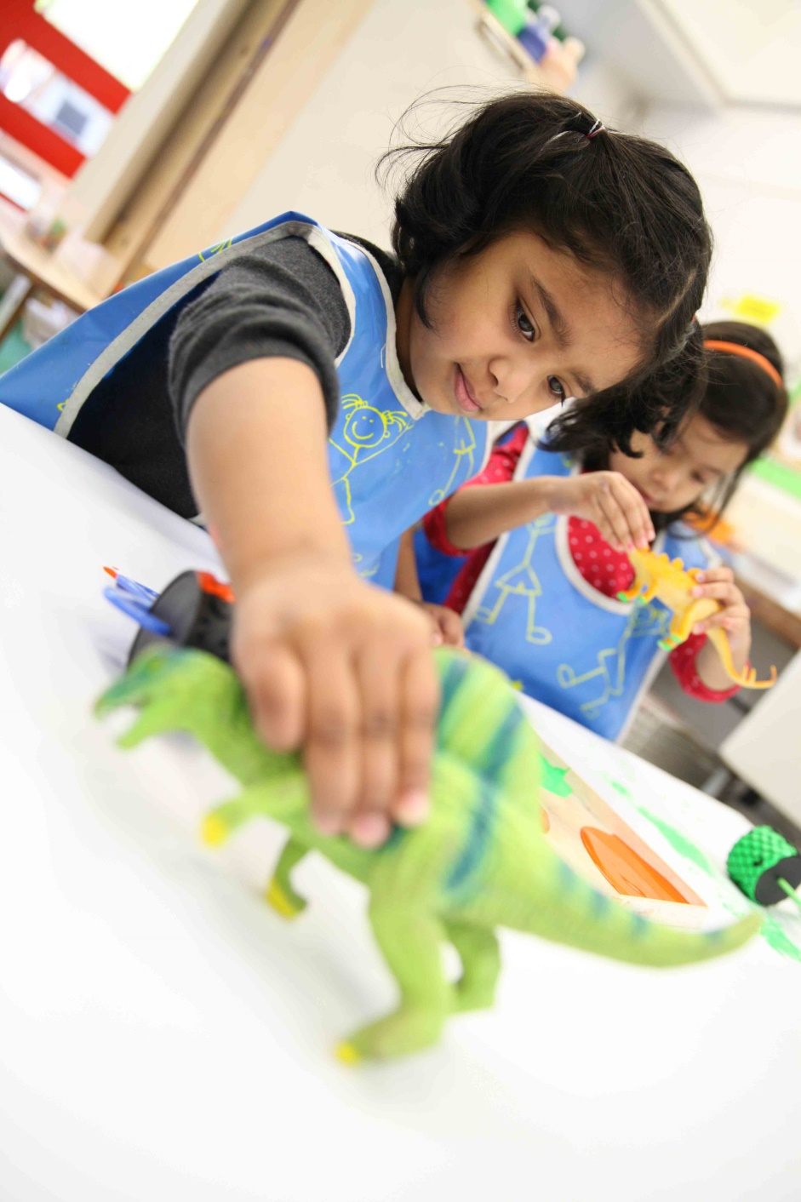
The Tapscott Learning Trust Teacher Person Specification
Knowledge and Understanding
Good understanding of the role of parents and the community in school improvement and how this can be practiced and developed
Clear understanding of how to use formative assessment and other information to impact on achievement and attainment
Knowledge of key aspects of safeguarding including latest guidance, processes and procedures
We’d love to have a chat about why this could be the next career move for you. Call on 020 3108 0236 and ask to either Danny, Training Hub Director or Paul, CEO. You can talk about the opportunity and get a feel for whether it’s right for you.
To apply, visit www.jobsgopublic.com and search for
‘The Tapscott Learning Trust'
The Tapscott Learning Trust, Atlas Road, London E13 0AG info@ttlt.academy www.ttlt.academy

