Slide 1
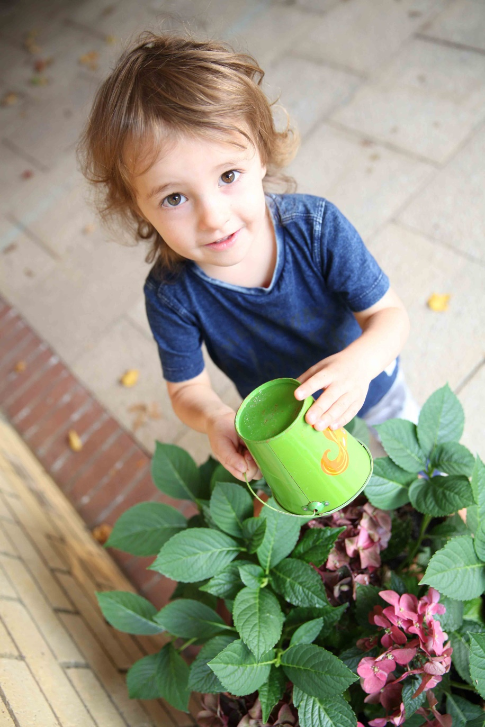

North Beckton Primary School Job Profile
Post: Class Teacher (TLRs available if relevant).
Scale: MPS depending on experience; NQTs are welcome to apply
Responsibilities
Teach a class of pupils and ensure that planning, preparation, assessment and reporting meet their varying learning and social needs.
Maintain the positive ethos and core values of the school, both inside and outside the classroom.
Ensure that the current national teacher standards for school teachers are met.
Implement agreed school policies and guidelines.
Have the highest expectation of every child, believing that every learner has unlimited potential for development.
Set clear targets, based on prior attainment, for pupils’ learning.
Plan and resource a classroom environment which will encourage the development of all aspects of children’s learning including their independent use of resources and involvement in their learning.
Have high standards in the content and presentation of pupils’ work.
Maintain a positive learning environment, in accordance with the school’s behaviour and positive relationship policy.
Work in partnership with parents and carers in providing a quality education experience for all the children and report to parents on the development, progress and attainment of pupils.
Participate in meetings which relate to the school’s management, curriculum, administration or organisation.
Communicate and co-operate with specialists from outside agencies.
Lead, organise and direct support staff within the classroom.
Participate in the appraisal system.
North Beckton Primary School, Harrier Way, London E6 5XG
Tel: 020 7473 3344
E: info@northbeckton.newham.sch.uk
www.northbeckton.newham.sch.uk

Slide 2
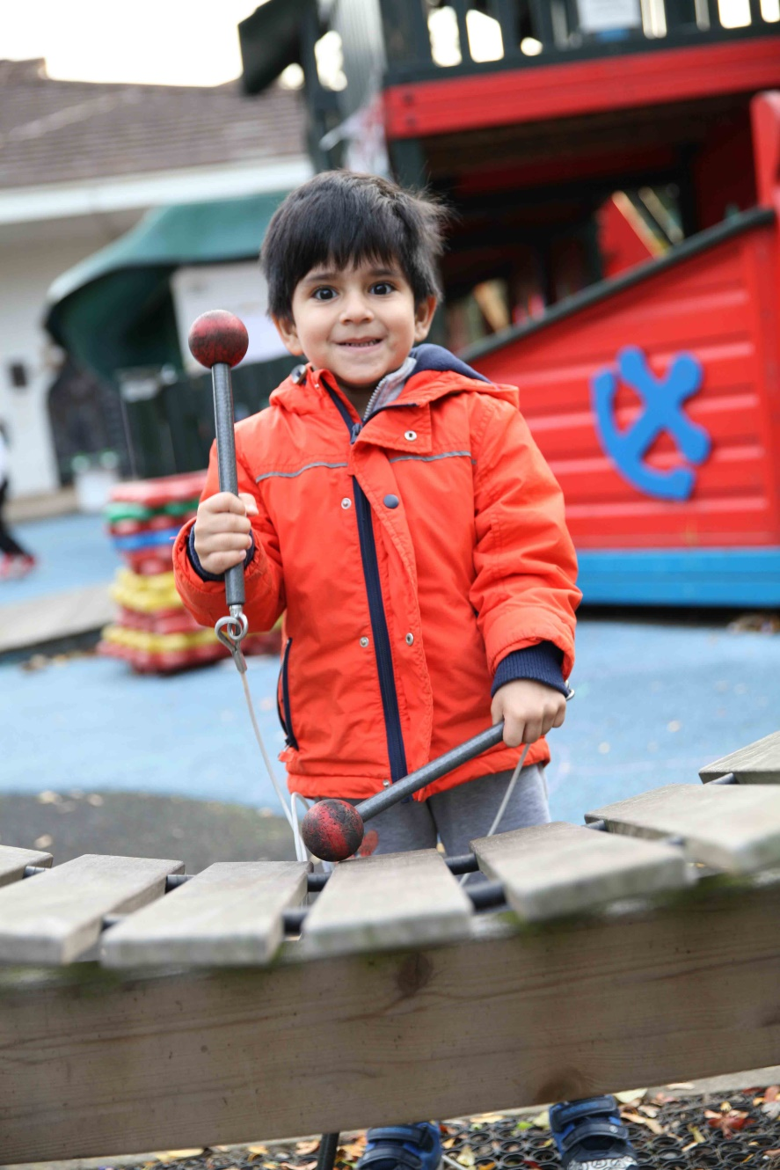
North Beckton Primary School Job Profile
Equality and Diversity
The Tapscott Learning Trust is an Equal Opportunity Employer and recognises that some candidates may have been forced into an untypical or unconventional career path because of unavoidable personal circumstances or the prejudice they have met in life. Should this apply to you, we hope you will not be deterred from making an application, which will be considered on your overall fulfilment of the requirements of this job specification.
As a school, we are committed to and champion equality and diversity in all aspects of employment with The Tapscott Learning Trust. All employees are expected to understand and promote equality and diversity in the course of their work.
The above are intended to be a guide to the range and level of work expected of any member of staff. It is not an exhaustive list of all the tasks that may be asked of an employee. He/she will be expected to carry out such other reasonable duties, which may be required from time to time across our MAT.
We’d love to have a chat about why this could be the next career move for you. Please call 020 7473 3344 and ask to speak to Alison Helm ,our Head Teacher, and we can talk about the opportunities available and get a feel for whether North Beckton is right for you.
To apply, visit www.jobsgopublic.com and search for‘North Beckton’.
North Beckton Primary School, Harrier Way, London E6 5XG
Tel: 020 7473 3344
E: info@northbeckton.newham.sch.uk
www.northbeckton.newham.sch.uk

