Slide 1
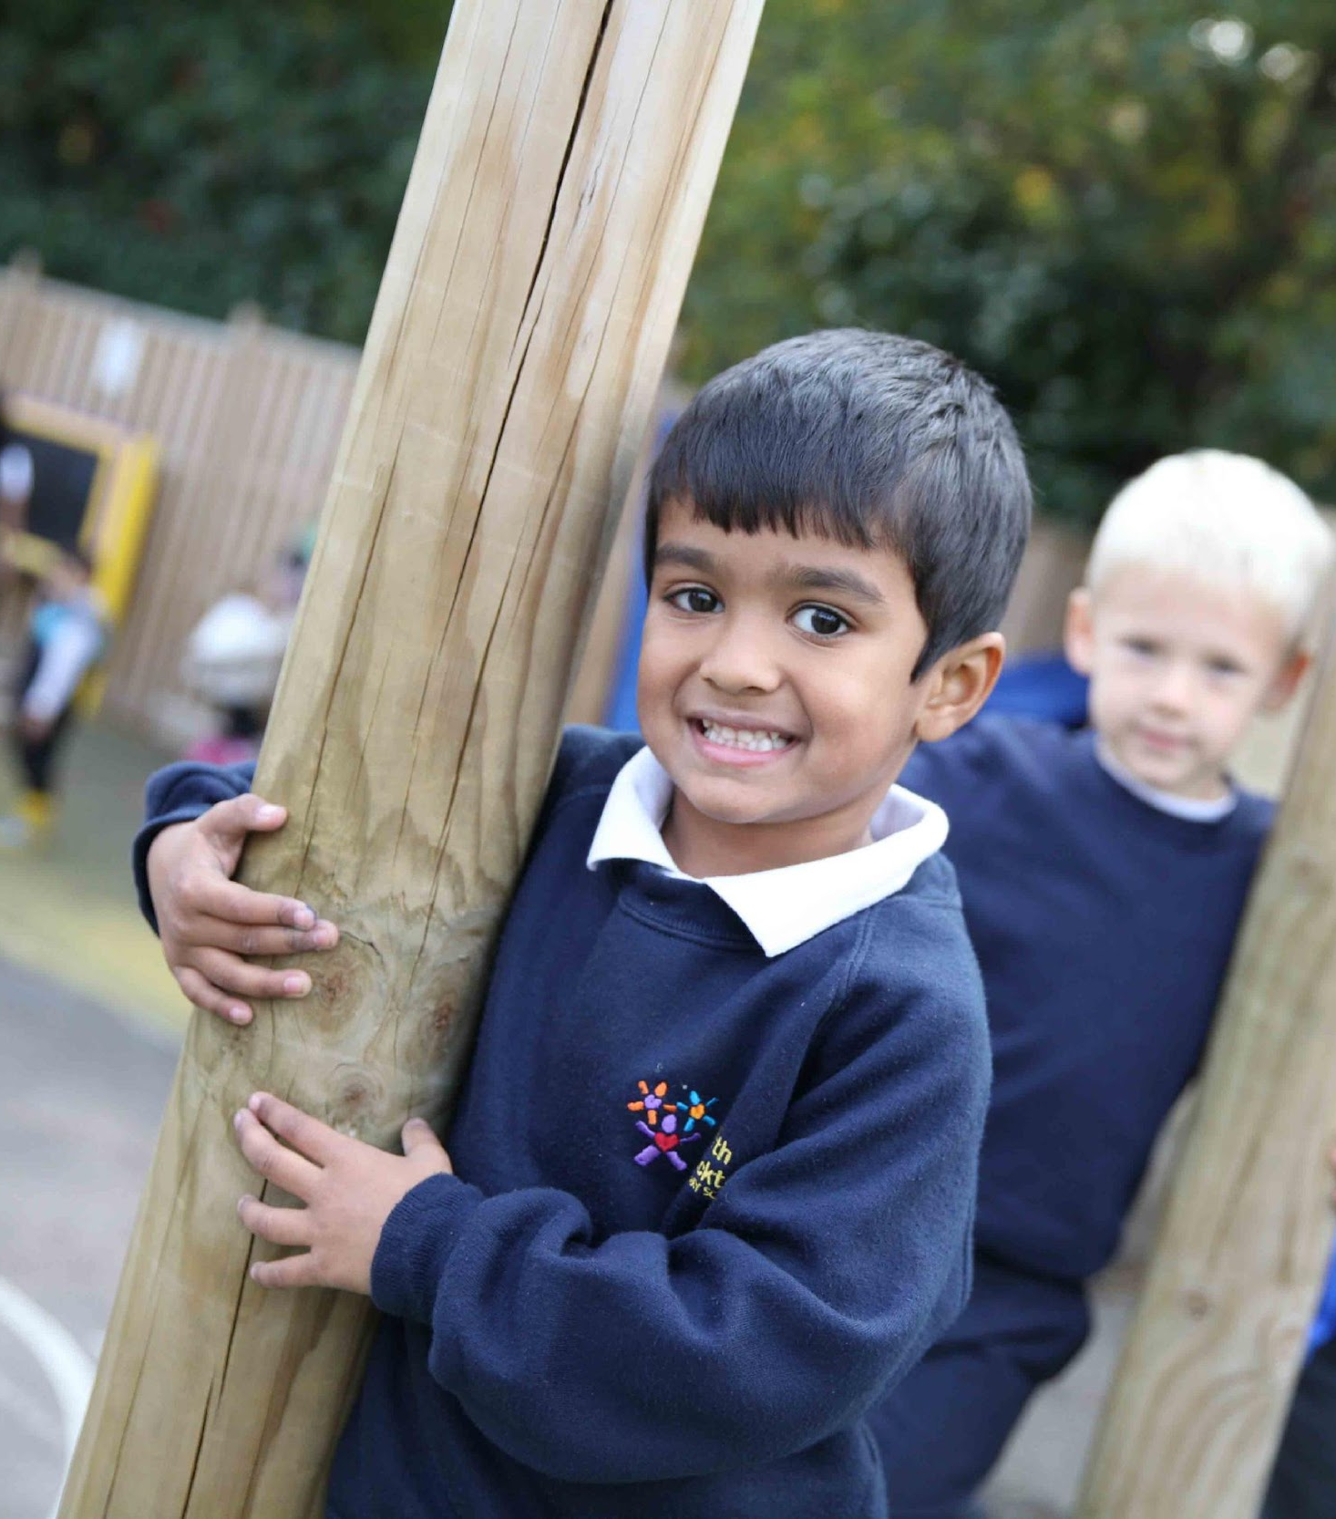


We All Belong
As we continue to grow, we are looking to recruit inspiring teachers who can join our dedicated team in September 2020.
We would love to have a chat about why this could be the next career move for you. Please call on 020 8473 3344 and ask to speak to Alison Helm, our Head Teacher. We can talk about the opportunities available and you can get a feel for whether North Beckton is right for you.
To apply, visit www.jobsgopublic.com and search for ‘North Beckton’.
With the support of The Tapscott Learning Trust, a very positive culture in which learning and achievement are at the heart of the school has been established’ HMI (May, 2018)

Slide 2
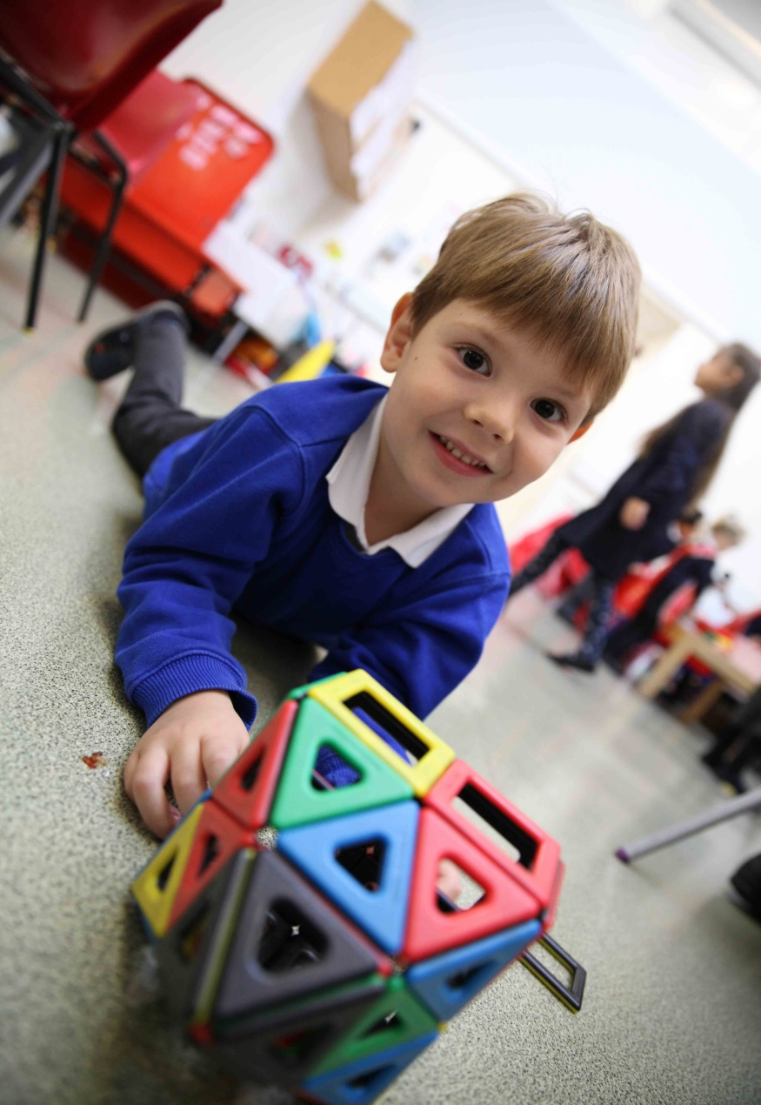


Why North Beckton?
We believe that our website gives an excellent feel for what we are all about:
https://www.northbeckton.newham.sch.uk
Children first
At North Beckton, our children are at the centre of everything we do and our embedded school ethos is “We All Belong”. We have a resource provision for pupils with PMLD and we are very proud of our new re-build for these pupils in the heart of our school. We are also fully committed to supporting our pupils’ mental well-being and this is at the core of all our relationships within the school. We are about to launch a full new curriculum in September and would welcome your input into this exciting new journey for the school.
Ongoing high-quality career development
We are fully committed to helping you grow and develop. Our tailored CPD programmes provide clear pathways for your development while our bespoke leadership programme (in partnership with the TTLT and the IOE) develops the skills and knowledge you need to progress in your career.
Making a difference
At North Beckton you truly are making a difference. Many of our children have recently arrived in this country, others face substantial challenges. Whatever their background, school is often their sanctuary. They are incredibly eager to learn, make astounding progress, and repay your dedication with a faultless attitude to their work.
Committed community
Our community and our children are fully committed to their learning:
- 96% of parents would recommend the school to another parent
- 100% of parents say the school has high expectations for their child.
- 98% of parents say their child is happy at the school.
‘Since the appointment of the Headteacher in May 2017, effective action has been taken to raise standards and improve pupil outcomes’ HMI [May 2018]
North Beckton Primary School, Harrier Way, London E6 5XG
Tel: 020 7473 3344
E: info@northbeckton.newham.sch.uk
www.northbeckton.newham.sch.uk

Slide 3
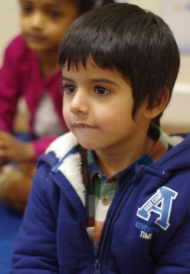
Opportunities for inspirational teachers
Start date: September 2020
Permanent, full-time positions and 1 year maternity cover positions available
Salary: MPS or UPS depending on experience; TLRs available
NQTs and experienced are welcome to apply
Inner London pay
Support with Technology
- Access to SAS healthcare
Close to public transport
Lots of outdoor space including a Forest School and Edible Playground
Closing date for applications: Friday 24th April 2020
Shortlisting: Tuesday 28th April 2020
(Virtual) Interviews: w/c 4th May 2020
Our incredible team is looking to take our school out of RI at our next Ofsted Inspection
As we continue to grow, we are looking for teachers, who have new ideas and energy to contribute to our team; both at North Beckton and as part of the wider Tapscott Learning Trust.
For the right candidate there are unparalleled opportunities and this is your chance to find out whether North Beckton is the right fit for you. We would love to have a chat about why this could be the next career move for you so please call on 020 8470 2339 and ask to speak to Alison Helm, our Head Teacher. We can then talk about the opportunities available and you can get a feel for whether North Beckton might be the right for you.
‘The considerable work undertaken by the Head and her staff to put the curriculum on a proper footing has revitalized teaching.’
HMI [May 2018]
To apply, visit www.jobsgopublic.com and search for ‘NorthBeckton'.
North Beckton Primary School, Harrier Way, London E6 5XG
Tel: 020 7473 3344
E: info@northbeckton.newham.sch.uk
www.northbeckton.newham.sch.uk

Slide 4
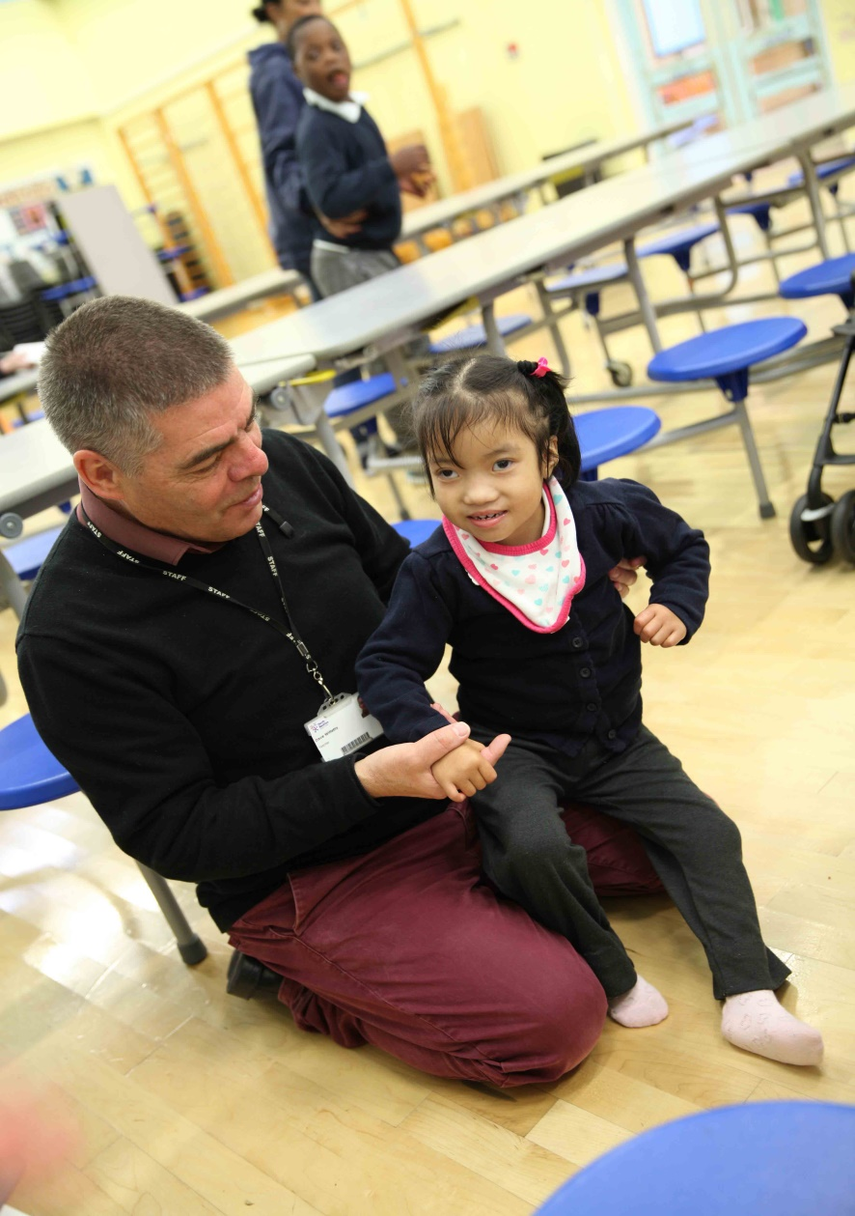
Opportunities for inspirational teachers
We need teachers who:
Are fully committed to being their best for the children.
Know that pupils’ wellbeing is as important as their academic progress.
Are enthusiastic and passionate about what they do.
Can enjoy themselves and their work with a smile and sense of humour.
Are ambitious for themselves and the children.
At North Beckton, we can offer:
An exciting work place.
A committed and hardworking team of pupils, parents, staff and governors.
Outstanding behaviour.
A positive, welcoming, open culture.
Fantastic future opportunities to grow your career.
Improved facilities and building, with a vibrant and welcoming atmosphere.
All appointments will be subject to a successful enhanced DBS check, medical check, receipt of satisfactory references and other relevant background checks. We are committed to safeguarding and promoting the welfare of children and expect all staff to support this commitment.
Equal Opportunities: North Beckton Primary School has a strong commitment to achieving equality of opportunity in both services to the community and the employment of people and expects all employees to understand and promote its policies in their work.
‘Teachers work together to plan the curriculum and make sure that learning is built upon in a structured way’
HMI [May 2018]
North Beckton Primary School, Harrier Way, London E6 5XG
Tel: 020 7473 3344
E: info@northbeckton.newham.sch.uk
www.northbeckton.newham.sch.uk

